Slide 1

CONTENTS
Introduction to 80386 & 80486
Ramachandra College of Engineering

Slide 2
INTRODUCTION TO 80386
80386 Architecture The internal architecture of the 80386 includes six functional units that operate in parallel.
The parallel operation is called as pipeline processing. Fetching, decoding execution, memory management, and bus access for several instructions are performed simultaneously.
The six functional units of the 80386 are
Bus Interface Unit
Code Pre-fetch Unit
3. Instruction Decoder Unit
4. Execution Unit
5. Segmentation Unit
6. Paging Unit
Ramachandra College of Engineering

Slide 3
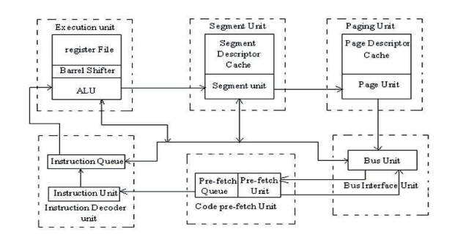
CONTD…..
Ramachandra College of Engineering

Slide 4
CONTD…..
• The Bus Interface Unit connects the 80386 with memory and I/O. Based on internal requests for fetching instructions and transferring data from the code pre-fetch unit, the 80386 generates the address, data and control signals for the current bus cycles.
• The code pre-fetch unit pre-fetches instructions when the bus interface unit is not executing the bus cycles. It then stores them in a 16-byte instruction queue for decoding by the instruction decode unit.
• The instruction decode unit translates instructions from the pre-fetch queue into micro- codes. The decoded instructions are then stored in an instruction queue (FIFO) for processing by the execution unit.
Ramachandra College of Engineering

Slide 5
CONTD…..
The execution unit processes the instructions from the instruction queue. It contains a control unit, a data unit and a protection test unit.
• The control unit contains microcode and parallel hardware for fast multiply, divide and effective address calculation. The unit includes a 32-bit ALU, 8 general purpose registers and a 64-bit barrel shifter for performing multiple bit shifts in one clock. The data unit carries out data operations requested by the control unit.
• The protection test unit checks for segmentation violations under the control of microcode.
• The segmentation unit calculates and translates the logical address into linear addresses at the request of the execution unit.
Ramachandra College of Engineering

Slide 6
CONTD…..
• The translated linear address is sent to the paging unit. Upon enabling the paging mechanism, the 80386 translates these linear addresses into physical addresses. If paging is not enabled, the physical address is identical to the linear address and no translation is necessary….
Ramachandra College of Engineering

Slide 7
80486 Architecture
80486 Architecture
The 32-bit 80486 is the next evolutionary step up from the 80386.
• One of the most obvious feature included in a 80486 is a built in math coprocessor. This coprocessor is essentially the same as the 80387 processor used with a 80386, but being integrated on the chip allows it to execute math instructions about three times as fast as a 80386/387 combination.
• 80486 is an 8Kbyte code and data cache.
• To make room for the additional signals, the 80486 is packaged in a 168 pin, pin grid array package instead of the 132 pin PGA used for the 80386.
Ramachandra College of Engineering

Slide 8
CONTD…..
• Operates on 25MHz, 33 MHz, 50 MHz, 60 MHz, 66 MHz or 100MHz.
• It consists of parity generator/checker unit in order to implement parity detection and generation for memory reads and writes.
• Supports burst memory reads and writes to implement fast cache fills.
• Three mode of operation: real, protected and virtual 8086 mode.
• The 80486 microprocessor is a highly integrated device, containing well over 1.2 million transistors .
Ramachandra College of Engineering

Slide 9
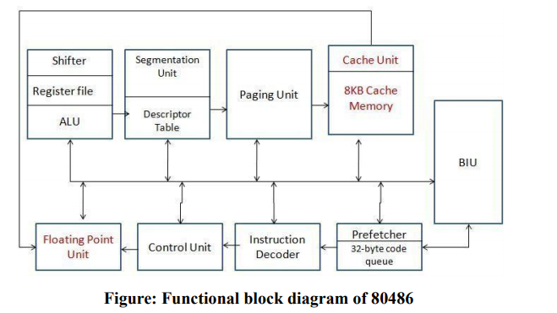
CONTD…..
The architecture of the 80486DX is almost identical to the 80386. Added to the 80386 architecture inside the 80486DX is a math coprocessor and an 8K-byte level 1 cache memory.
Ramachandra College of Engineering

Slide 10
CONTD…..
BIU:
• BIU generates address, data and control signals for a bus cycle it is supported with an additional parity detection/generation for memory reads and writes.
• During memory write operation, the 486 generates even parity bit for each byte outputs these bits.
• These bits will be stored in a separate parity memory bank.
• During read operation, stored parity bits will be read from the parity memory.
• 80486 checks the parities of data bytes read and compare them with the DP0 – DP3 signals and generates parity check error, if it occurs.
Ramachandra College of Engineering

Slide 11
CONTD…..
• It pre-fetches the instruction bytes in advance and holds them in a 32–byte code queue.
Instruction Decoder:
• Decodes the instructions in the queue and passes the control and protection test unit.
Execution Unit:
• Executes the instruction with the help of Barrel Shifter, ALU and Register bank.
Ramachandra College of Engineering

Slide 12
CONTD…..
Segmentation Unit and Paging Unit:
• They are part of MMU (which manages virtual memory of system). Helpful in generation of Physical Address.
• Work same as they work in 80386.
• Responsible for performing the floating point operations.
• The 80486 has a built in math co-processor. It performs the floating point operations.
• It executes math instructions 3 times faster than the 386/387 combination
Ramachandra College of Engineering

Slide 13
CONTD…..
Cache Unit:
• 8KB cache
• Additional high speed cache memory provides a way of improving overall system performance.
• It contains the recently used instructions, data or both
• The main aim is that the microprocessor unit access code and data in the cache most of time, instead from the main memory.
Ramachandra College of Engineering

Slide 14
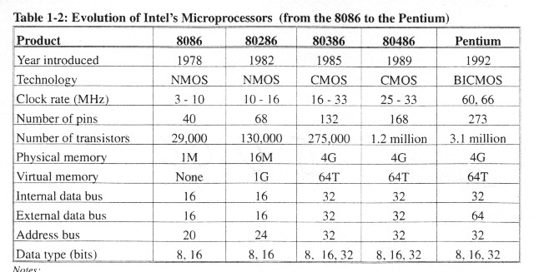
CONTD…..
Ramachandra College of Engineering

Slide 15
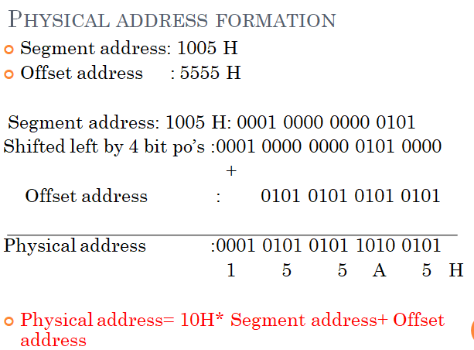
PHYSICAL ADDRESS CALCULATION
Ramachandra College of Engineering

Slide 16


